Slide 1
Operating System Principles - 1
Shyan-Ming Yuan
CS Department, NYCU
smyuan@gmail.com

Slide 2
Introduction - 1
Goal: Understand the basic concepts of an OS.
OS history
the design principle of separating mechanism from policy
Some terminologies of early Operating Systems:
Batch systems (1956): OSs would run a program to completion and then load and run the next program.
Multiprogramming (1960): OSs keep several programs in memory at once and switch between them. The primary goals are better system throughput and resource utilization.
Time-sharing (1961): multiprogramming with preemption, where the system may stop one process from executing and starts another. A single physical CPU is shared by multiple programs to create the illusion that each program is executed by a dedicated, slower virtual CPU.

Slide 3
Introduction - 2
Some terminologies of Modern Operating Systems:
Portable OS: an OS that is not tied to a specific hardware platform.
UNIX (1970) was one of the early portable operating systems.
Microkernel OS: an OS that only provides the bare essential mechanisms that are necessary to interact with the hardware and manage threads and memory.
Higher-level OS functions, such as managing file systems, the network stack, or scheduling policies, are delegated to user-level processes that communicate with the microkernel via interprocess communication mechanisms (usually messages).
Mach (1985), MINIX (1987) are two early microkernel OSs.

Slide 4
Introduction - 3
Personal Computer Operating Systems:
CP/M (1971~1975): dominant OS for 8080 family of machines
IBM PC and Microsoft DOS (1980s)
Microsoft Windows series (1990~)
Windows 3.0, Windows NT, Windows 95, ….
Open Source OSs (1990~)
Linux, FreeBSD, NetBSD, OpenBSD
Mobile Computer Operating Systems (2000~):
iOS, Android, BlackBerry OS, Windows Mobile

Slide 5
What is an operating system?
The first program runs when a computer starts
The program that lets users to run other programs
The program that provides controlled access to resources:
CPU
Memory
Display, keyboard, mouse
Persistent storage
Network
…..

Slide 6
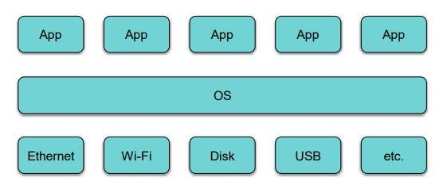
The Operating System

Slide 7
The Design Principle of OS
A mechanism is the presentation of a software abstraction:
the functional interface.
It defines how to do something.
A policy defines how that mechanism behaves.
e.g., enforce permissions, time limits, or goals.
Driving a car is defining a policy and the interfaces provided by a car are mechanisms.
A Good OS design principle is to
keep mechanisms and policies separate.

Slide 8
Booting an Operating System
Boot loader: is a small program that is run at boot time that loads the operating system.
Boot loaders are sometimes broken into several stages.
A multi-stage boot loader starts off with a simple boot loader that then loads a more sophisticated boot loader that then loads the OS.
This cascaded boot sequence is called chain loading.
Two well known chain loading mechanisms are
Basic Input/Output System (BIOS) based booting
Unified Extensible Firmware Interface (UEFI) based booting
Upon loading the OS, the boot loader transfers control to the OS.
The OS will initialize itself and load various modules as needed (for example, device drivers and various file systems)

Slide 9
OS Essential Concepts
An operating system contains of the following functionalities.
It is a program that loads and runs other programs.
It provides programs with a level of abstraction so they don’t have to deal with the details of accessing hardware.
It manages access to resource, including
the CPU (via the scheduler),
memory (via the memory management unit),
persistent files (via the file system),
a communications network (via sockets and IP drivers), and
devices (via device drivers).

Slide 10
Kernel Mode vs User Mode
The operating system (the microkernel or kernel) runs in kernel mode (also called privileged, supervisor, or system mode).
In this mode, the processor can execute privileged instructions:
define interrupt vectors,
enable or disable system interrupts,
interact with I/O ports,
set timers and
manipulate memory mappings.
Programs other than the kernel run in user mode and do not have privileges to execute these instructions.

Slide 11
Mode Switch
A processor running in user mode can switch to kernel mode by executing a trap instruction, also known as a software interrupt.
Some processors also offer explicit system call instructions.
This is a faster mechanism since it does not need to read the branch address from an interrupt vector table (in memory) but keeps that address in a CPU register.
Both approaches can switch the processor to kernel mode.
It saves the current program counter on the stack, and transfers execution to a predefined address for that trap.
Control is switched back to user mode and to the location right after the trap by executing a return from exception instruction.

Slide 12
System Calls
User processes can interact with the OS via system calls.
A system call uses the trap mechanism to switch control to OS code running in kernel mode.
A system call does the following:
Set the system call number
Save parameters
Issue the trap (jump to kernel mode)
OS gets control
Saves registers, does the requested work
Return from exception (back to user mode)
Retrieve results and return them to the calling function
System call interfaces are encapsulated as library functions

Slide 13
How Can the OS Get Control?
When the OS decides that a process has been executing long enough, it may preempt that process to run another process.
To allow the OS to get control at regular intervals, a programmable interval timer can be configured to generate periodic hardware interrupts, for example every 10 milliseconds.
It is crucial for:
Preempting a running process to give someone else a chance to run
forcing a context switch or killing the running process
Giving the OS a chance to poll hardware status
Bookkeeping OS statistics

Slide 14
Timer Interrupt and Context Switch
On timer interrupt, control is transferred to an interrupt handler in the kernel and the processor is switched to kernel mode.
When the OS is ready to return back, it issues a return from exception instruction.
If the OS decides it is time to replace the currently executing process with another process, it will save the current process’ context and restore the saved context of another process.
The context includes the values of a processor’s registers, program counter, stack pointer, and memory mappings.
Saving the context of one process and restoring that of another is called a context switch.

Slide 15
I/O Devices
The OS is responsible for managing system devices.
Three typical categories of devices are:
Character devices: mice, keyboard, audio, scanner, etc.
Byte streams.
Block devices: disk drives, flash memory
Persistent storage with addressable blocks (suitable for caching)
This cache of frequently-used blocks of data is called the buffer cache.
Basically, any device that can be used to hold a file system is a block device.
Network devices: Ethernet & wireless networks
Packet-based I/O.

Slide 16
Interacting with Devices
Devices have command (device) registers for the following OPs:
Transmit, receive, data ready, read, write, seek, status
Memory mapped I/O
Map device registers into memory
Standard memory load/store instructions can be used to interact with the device
When is the device ready?
Polling
Wait for device to be ready
To avoid busy loop, check status in each clock interrupt
Interrupts from the device
Interrupt when device has data or when the device is done transmitting
No checking needed – but extra context switch may be costly

Slide 17
Moving Data to/from Devices
Programmed I/O (PIO):
Data can be transferred between the device and system via software that reads/writes the device’s memory.
Use memory-mapped device registers
The processor is responsible for transferring data to/from the device by writing/reading these registers
Direct Memory Access (DMA):
Allow the device to access system memory directly.
The device may have access to the system’s memory bus and can use direct memory access (DMA) to transfer data to/from system memory without using the processor.

Slide 18
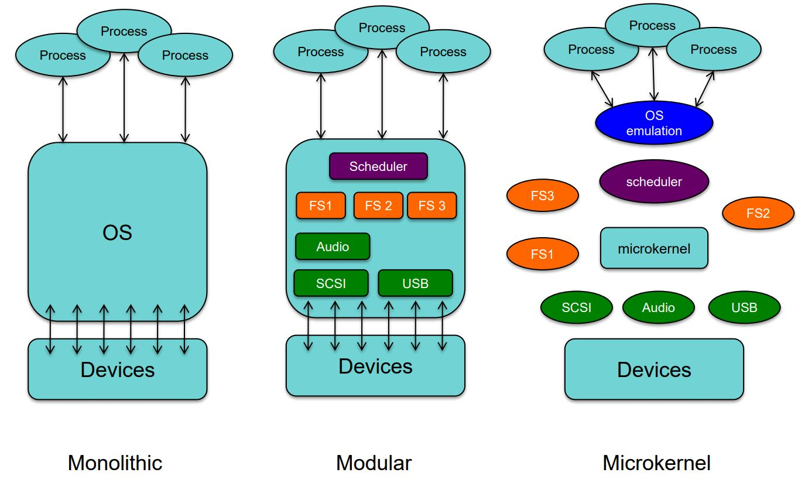
OS Structures

Slide 19
Process
A program is a file that contains of code and static data.
A process is a program in execution.
Each process has its own address space. It comprises the state of the processor’s registers and the memory map for the program.
The memory map contains several regions. These regions are:
Text: compiled program (the machine instructions)
Data: initialized static and global data
Bss: uninitialized static data that was defined in the program
global uninitialized strings, numbers, structures, etc.
Heap: dynamically allocated memory (obtained in run time)
Stack: the subroutine call stack
return addresses, local variables, temporary data, saved registers, etc.

Slide 20
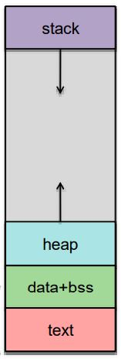
Memory Map
Stack expanded automatically
Heap can grow via a system call that requests more memory
Text (code) & initialized data come from the stored program

Slide 21
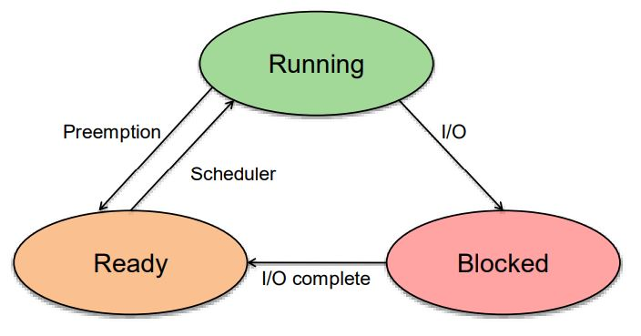
Process States
A process may be in one of three states:
running: the process is currently executing code on the CPU
ready: the process is not currently executing code but is ready to do so if the OS would give it the chance
blocked (or waiting): the process is waiting for some event to occur (such as a requested I/O operation to complete) and will not ready to execute instructions until this event is ready

Slide 22
Scheduler and PCB
The process scheduler of an OS is responsible for moving processes between the ready and running states.
An OS can save the context of a running process and restore the context of another ready process to run is called a preemptive multitasking system.
Most current operating systems are preemptive multitasking.
Systems that allow program to run until it terminates or blocks on I/O are called nonpreemptive.
An OS keeps track of all processes via a list.
Each element in the list points to a data structure, called a process control block (PCB), that contains information about one process.
The PCB stores all relevant information about the process.

Slide 23
The Process Control Block
A Process Control Block (PCB) may contain:
Process ID (and process group ID)
Machine state (registers, program counter, stack pointer)
Parent & list of children
Process state (ready, running, blocked)
Memory map
Open file descriptors
Owner (user ID) – determine access & signaling privileges
Event descriptor if the process is blocked
Signals that have not yet been handled
Policy items: Scheduling parameters, memory limits, etc.
Timers for accounting (time & resource utilization)

Slide 24
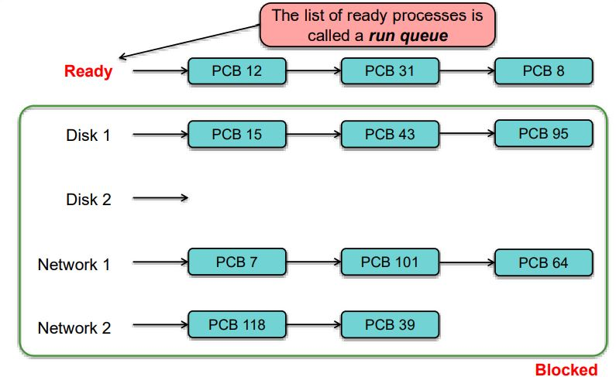
Processes on Ready & Blocked Queues
The list of ready processes is called a ready queue

Slide 25
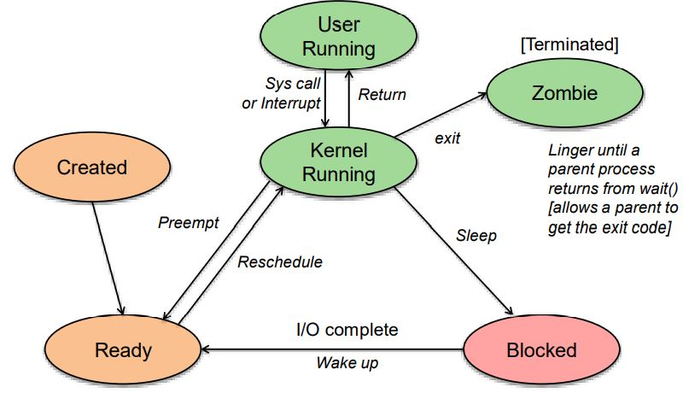
Process States: a more detail

Slide 26
The POSIX
POSIX stands for portable operating system interface of UNIX.
It was first released by IEEE in 1988. Latest version was in 2017.
It defines the application programming interface (API), along with command line shells and utility interfaces, for software compatibility with variants of Unix and other operating systems.
Most modern OSs compliant to POSIX or at least partly support.
POSIX-certified OSs include:
AIX, HP-UX, macOS, IRIX, Solaris, etc..
Mostly POSIX-compliant include:
Android, FreeBSD, Linux, MINIX, NetBSD, VMware ESXi, etc.
There are all kinds of POSIX compliant toolkits for Microsoft Windows
Windows Subsystem for Linux (WSL) by Ubuntu
Windows C Runtime Library and Windows Sockets API, by Microsoft

Slide 27
Process Management in POSIX
Fork() creates a new process.
Execve() loads a new program to the current process.
Exit() tells the operating system to terminate the current process.
Wait() allows a parent process to wait for and detect the termination of child processes.
Signal() allows a process to detect signals.
Kill() sends a signal to a specified process(es).

Slide 28
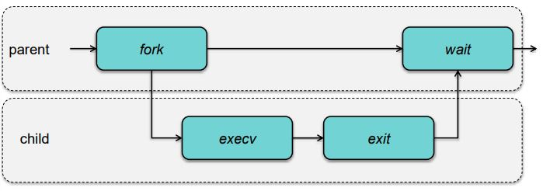
Parent & child processes

Slide 29
Thread
A thread can be thought of as the part of a process that is related to the execution flow.
A process may have one or more threads of execution.
A process with more than one thread is said to be multithreaded.
A thread-aware OS keeps track of processes via a list of PCBs.
Each PCB keeps a list of thread control blocks (TCBs) for that process.
A TCB keeps only thread-specific information
registers, program counter, stack pointer, priority, etc..
All other information that is shared among threads in a process is stored within the PCB.

Slide 30
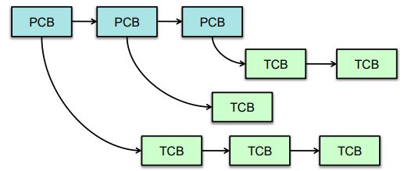
PCB & TCB
Each PCB contains one or more TCBs:
Thread ID
Saved CPU registers
Other per-thread info (signal mask, scheduling parameters)

Slide 31
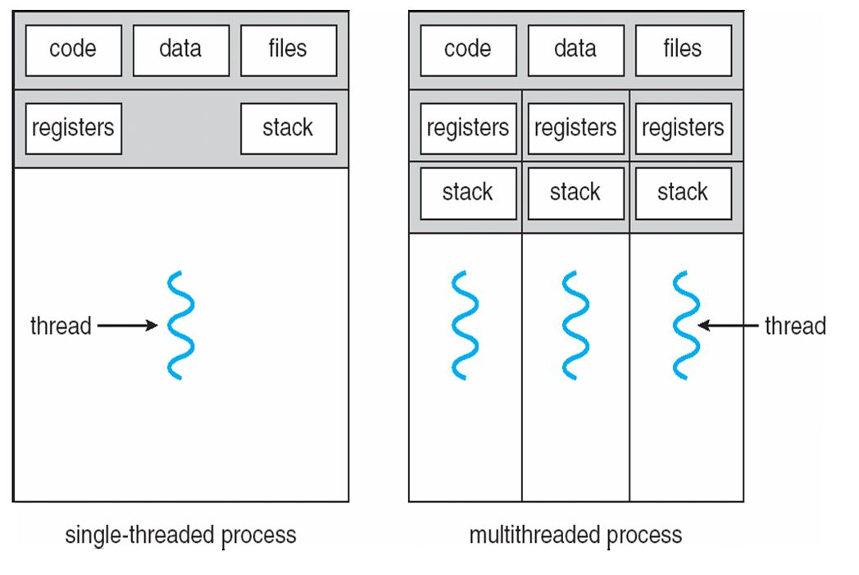
Single and Multithreaded Processes

Slide 32
Thread Sharing
Threads share:
Text segment (instructions)
Data segment (static and global data)
BSS segment (uninitialized data)
Open file descriptors
Signals
Current working directory
User and group IDs
Threads do not share:
Thread ID
Saved CPU registers,
Stack pointer
Program counter
Stack (local variables, temporary variables, return addresses)
Signal mask
Priority (scheduling information)

Slide 33
Advantage of Threads
Threads are more efficient
Much less overhead to create: no need to create new copy of memory space, file descriptors, etc.
Sharing memory is easy (automatic)
No need to figure out inter-process communication mechanisms
Take advantage of multiple CPUs – just like processes
Program scales with increasing # of CPUs
Take advantage of multiple cores

Slide 34
Thread Implementations
Kernel-level threads
Threads supported by operating system
OS handles scheduling, creation, synchronization
User-level threads
Library with code for creation, termination, scheduling of threads
Kernel sees one execution context: one process
May or may not be preemptive
Hybrid threading models: use user-level thread library on top of kernel threads.
1:1 – kernel threads only (1 user thread = 1 kernel thread)
N:1 – user threads only (N user threads on 1 kernel thread)
N:M – hybrid threading (N user threads on M kernel threads, N>M)

Slide 35
User-Level Threads
Advantages:
Low-cost: user level operations without switching to the kernel mode
Scheduling algorithms can be replaced easily & customized
The thread library can have its own thread scheduling algorithm that is optimized to a specific job
Greater portability
Disadvantages:
If a thread is blocked, all threads for the process are blocked
Unless asynchronous I/O calls are supported
Cannot take advantage of multiprocessors

Slide 36
POSIX Threads: pthreads
POSIX.1c, Threads extensions (IEEE Std 1003.1c-1995)
Defines API for managing threads
Linux, Solaris, Mac OS X, NetBSD, FreeBSD all support pthreads
Microsoft Windows: pthread API library on top of Win32 API
Thread life cycle management APIs include:
pthread_attr_init(): initializes thread attributes
pthread_create(): creates a new thread
pthread_join(): waits for termination of other thread in the same process
pthread_exit(): terminates the calling thread itself
pthread_cancel(): terminates a target thread
All pthread functions must be compiled and linked with
-pthread option.

Slide 37
Concurrent Threads / Processes
Threads (or processes) are concurrent if they exist at the same time.
Concurrent threads (or processes) can be either independent or cooperating.
Independent threads (or processes) have no dependency on each other.
It does not affect a thread whether another thread (or process) exists or not.
Cooperating threads (or processes) can affect and be affected by the executions of other cooperating threads (processes.)
Cooperating threads (or processes) need to interact with each other through some synchronization mechanisms so that their relative order of execution can be guaranteed.

Slide 38
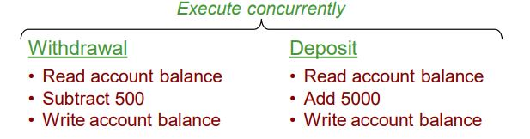
Race Condition
Cooperating threads may access shared data simultaneously.
If the consistent result depends on some specific data access orders, the race condition may occur.
Data consistency is maintained by synchronization mechanisms to ensure orderly execution of cooperating threads (processes.)
A race condition example
Assume that your current bank balance is $1,000.
When withdraw $500 from an ATM machine while a $5,000 direct deposit is coming in at the same time.
The possible new balances are $5500 $500 $6000

Slide 39
Critical Sections
A race condition typically occurs when two or more cooperating threads try to read and/or write the shared data concurrently.
The regions of a program that try to access shared resources and cause race conditions are called critical sections (CS.)
It is possible to avoid race conditions by allowing only one thread at a time to execute within a CS.
Race conditions can be avoided by using locks with CSs.
A thread must acquire the associated lock before entering a CS.
On exit a CS, a thread must release the associated lock.
If the associated lock is not ready, the acquiring thread must be blocked.

Slide 40
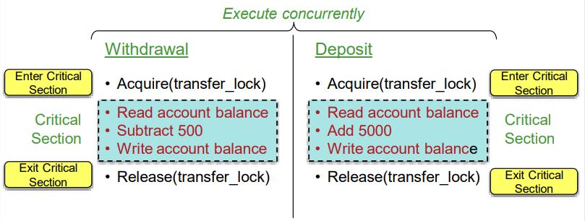
Critical Section with Lock
The consistent new balances are $5500

Slide 41
Features of CS Problem Solutions
Mutual exclusion:
No more than one thread may be inside the same CSs simultaneously.
Progress:
No thread running outside its critical section may block others.
If no thread in CS, then the next thread that will enter the CS must be decided in finite time.
Bounded waiting:
No thread should wait forever to enter a critical section.
A good solution will make no assumptions on:
the number of processors
the number of threads/processes
the relative speed of threads/processes

Slide 42
Peterson’s Algorithm
Shared Data {
int turn;
Boolean flag[2] ;
}
Thread(i), where (i=0 and j=1) or (i=1 and j=0)
do {
flag[i] = TRUE;
turn = j;
while (flag[j] && turn == j) { };
// empty while for busy waiting
critical section
flag[i] = FALSE;
remainder section
} while (TRUE);

Slide 43
Hardware Solutions
Many systems provide hardware support for critical section code
Uniprocessor system – disable interrupts
Currently running code would execute without preemption
In general, it is too inefficient on multiprocessor systems
Operating systems using this are not broadly scalable
Modern machines provide special atomic hardware instructions
Atomic means non-interruptable
test-and-set
swap

Slide 44
Solution to CS Problem Using Locks
do {
acquire lock
critical section
release lock
remainder section
} while (TRUE);
boolean TestAndSet (boolean *target)
{
boolean rv = *target; // get old value
*target = TRUE; // set to TRUE
return rv; // return old value
}
void Swap (boolean *a, boolean *b)
{
boolean temp = *a;
*a = *b;
*b = temp:
}

Slide 45
Solution using TestAndSet
shared boolean lock = FALSE; // shared by all threads
do {
while (TestAndSet (&lock)) { }; // do nothing
// critical section
lock = FALSE;
// remainder section
} while (TRUE);

Slide 46
Solution using Swap
shared boolean lock = FALSE; // shared by all threads
do { key = TRUE; // local to each thread
while ( key == TRUE)
Swap (&lock, &key );
// critical section
lock = FALSE;
// remainder section
} while (TRUE);

Slide 47
Spin Lock & Priority Inversion
The atomic-instruction-based locks require looping in software to wait until the lock is released.
This is called busy waiting or a spinlock.
If a high priority thread is spinlocking, it may prevent a low priority thread to release the waiting lock.
This situation is known as priority inversion.
Priority Inheritance may be used to avoid priority inversion.
Increase the priority of a thread that is in a CS to the maximum priority of all waiting threads for the associated lock.
When the lock is released, the priority goes back to its normal level.

Slide 48
Semaphores
Semaphore is a synchronization tool provided by OS so that threads can use for mutual exclusion and wait for a critical section without application level busy waiting.
Semaphore S is a special integer variable.
Semaphores can only be accessed via two atomic operations.
wait() and signal() (called P() and V() in the past.)
wait (S) {
while (S <= 0){ }; // busy waiting inside wait()
// no-op
S--;
}
signal (S) {
S++;
}

Slide 49
Semaphore as Synchronization Tool
Binary semaphore (Also known as mutex lock)
integer value can range only between 0 and 1
Counting semaphore
integer value can range over an unrestricted domain
can be implemented by a binary semaphore
CS problem can be solved by using semaphore
Semaphore mutex = 1; // initialized to 1
do {
wait (mutex); // acquire lock
// Critical Section
signal (mutex); // release lock
// remainder section
} while (TRUE);

Slide 50
No Busy Waiting Semaphore Implementation
Associate each semaphore with a waiting queue.
Each entry in the waiting queue has two data items:
value (of type integer) and pointer to next record in the list
Two special operations for the waiting queue:
block() places the invoking thread on the corresponding waiting queue.
wakeup() removes one of threads from the waiting queue and places it in the ready queue.
wait(semaphore *S) {
S->value --;
if (S->value < 0) {
add the calling thread T to S->list; block(T);
}
}
signal(semaphore *S) {
S->value++;
if (S->value <= 0) {
remove a thread T from S->list;
wakeup(T);
}
}

